Slide 1
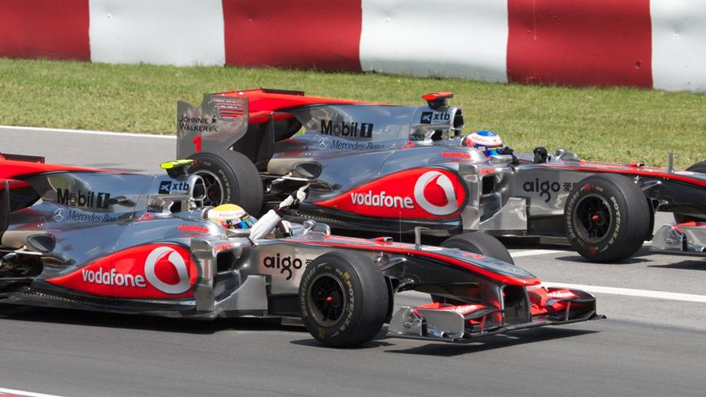
Factors affecting F1 Racing
By Tom Cahill, John Ng, Praveena Subramani, Andrea Sciubba

Slide 2
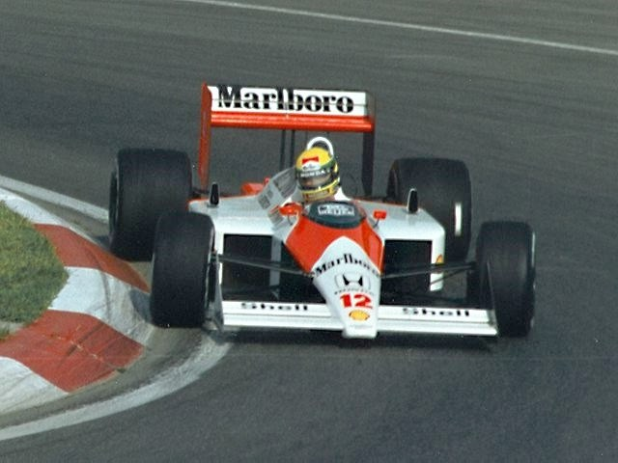
Our Story
The governing body of F1 racing, the FIA (Fédération Internationale de l'Automobile), has tasked data analysts from "F1 Fanatics" to review data from 1950 until 2020 to investigate factors affecting F1 races to help them grow the sport and better plan races for the future.

Slide 3

F1 Racing 101
Teams “constructors” have two race drivers for each race during the championship
Drivers compete individually and their points are also combined for their team points to go towards a constructors championship
Each race, drivers participate in a series of qualifying races to determine their start position on the grid; the faster the lap times, the better starting position
There are rules for the entire season and individual races e.g. the number of tyres, engines and modifications allowed, and minimum pit stops required in each race
Number of races vary each year; minimum 7 in 1950, maximum 20 in 2012, now there are generally 19 to 20
Over the 70 years, races have occurred in 32 countries at 77 racing circuits
78 laps per race, race cannot exceed 2 hours

Slide 4
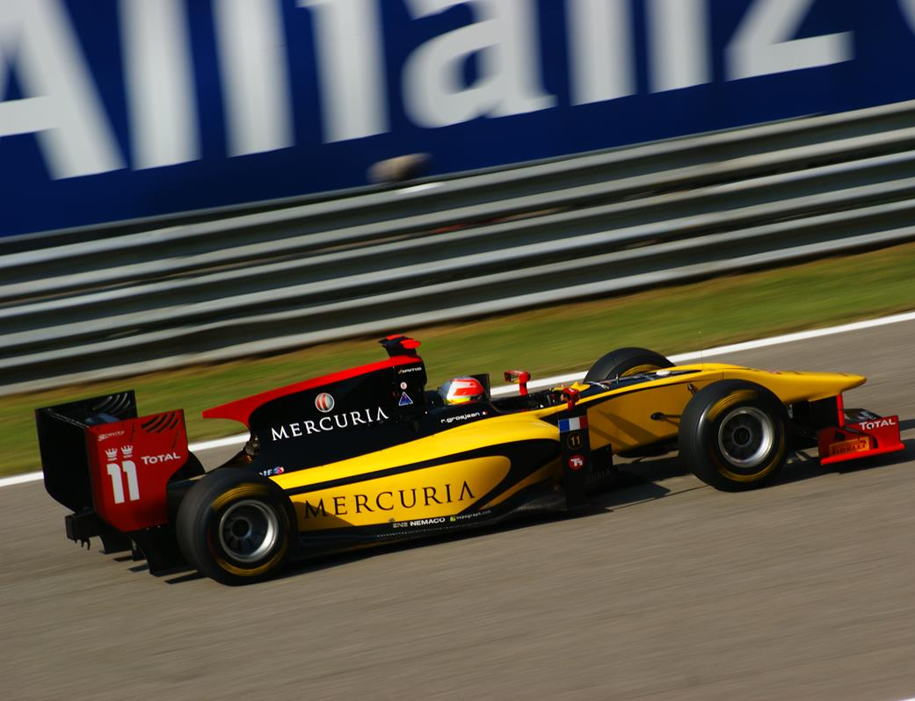
How and what we did
Ergast Developer API
http://ergast.com/mrd/
Data from 1950 to 2020
Imported 13 CSVs and merged into one dataframe
Number of races in each country
Country of origin for constructors
Nationality of drivers
Starting grid position
Pit stops
Fastest laps

Slide 5
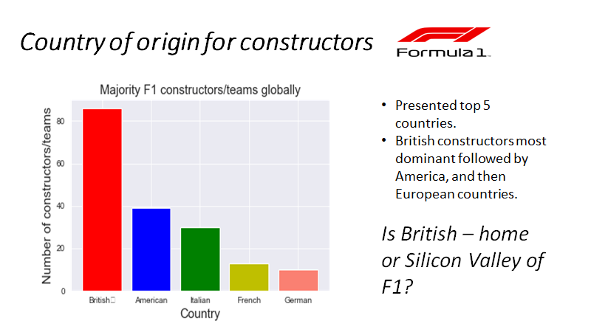

Slide 6
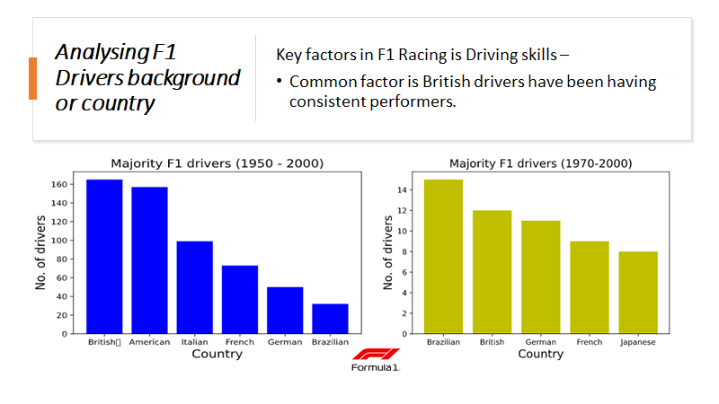

Slide 7
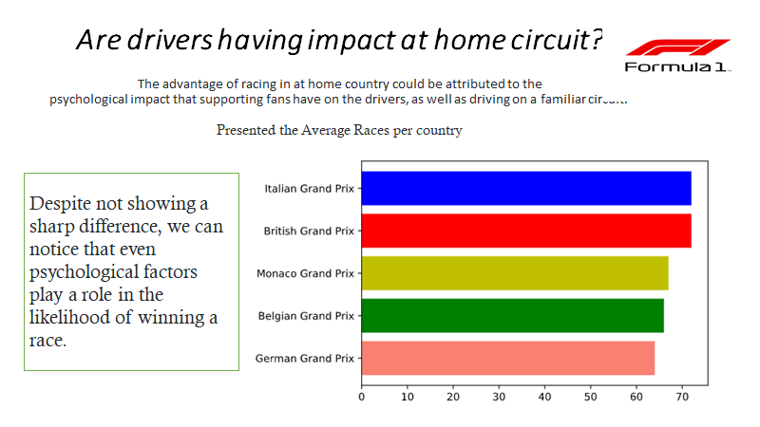

Slide 8
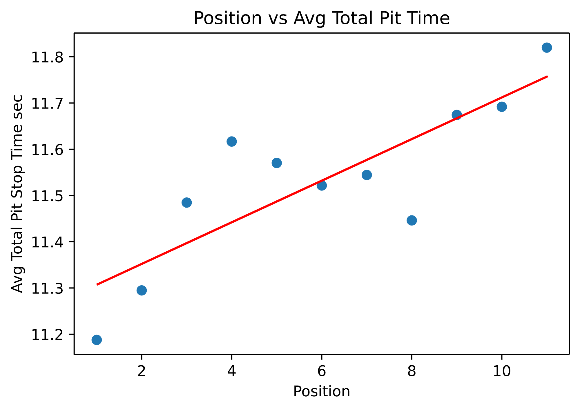
Pit stops
Average total pit stop time compared to finishing position
H0:pit stop times does not affect the finishing position
Filtered to finished top 10 positions
Strong positive linear correlation positions 1 to 10
Reasons: mechanical failures, crashes, pit stop crew error

Slide 9
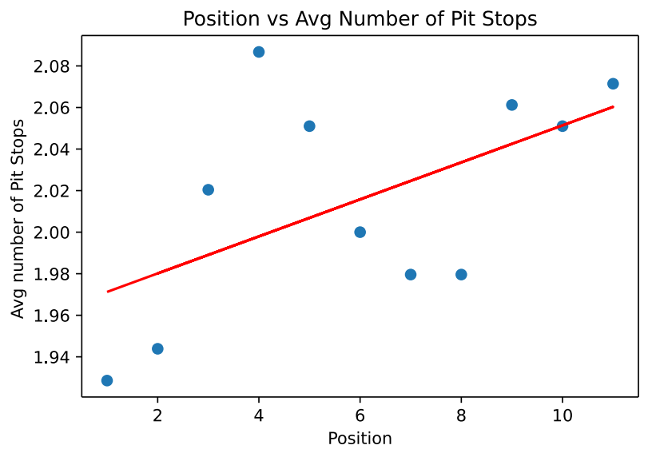
Average number of pit stops per race compared to finishing position
H0: The number of pit stops does not affect the finishing position
Filtered to look at top 10 finishing positions
Positive linear correlation
Pit stops are measured in whole numbers, it makes sense these numbers round to 2, with 2 being consistent with the minimum pit stops required per race
Trend: completing the minimum number of pit stops correlates with finishing in a better position

Slide 10
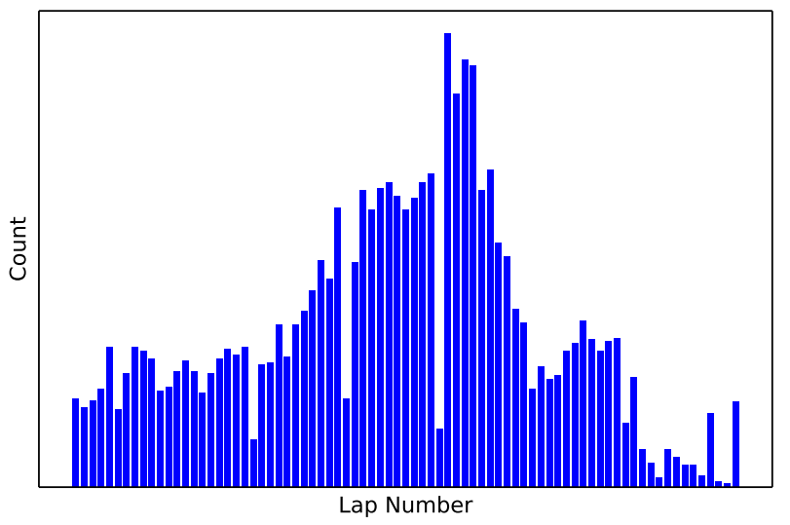
Fastest laps
At what point in the race do the fastest laps occur
The peak is approx the ¾ point into the race, at lap 50 (lap range 50 to 54)
Reasons: optimal conditions of the car (e.g. tyre condition), team strategy

Slide 11
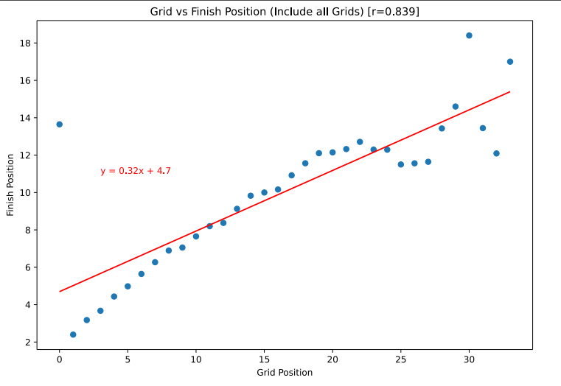
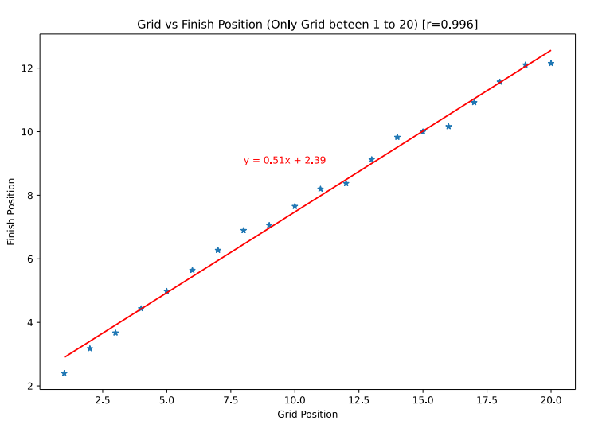
Grid position
Starting position on grid compared to finished position
H0: The starting grid position has no affect on the finishing position
Strong positive linear correlation for positions 1 to 20, then no consistent trend
Reasons: race originally had 34 grid positions then changed to 20, therefore more data collected

Slide 12

API
Asks the user to enter a year
Validates years between 1950 and 2020
Returns:
Name of winning driver for championship
Driver’s date of birth and nationality
Constructor they raced for

Slide 13
Challenges
Choosing if we should use the mean, count or sum of the column attribute, e.g. pit stop time graph used average total time
How we should group by, e.g. by grid position or by final position
Whether we should use the full dataset or subset of the date e.g. the most recent data in the past 10 years
Determining which variable is best plotted on the x and y axis and to test if it is more logical if they were switched.

Slide 14
Trends
Most constructors are British
British drivers are the most consistent and successful
Most races are located in Europe, there is an advantage if the constructor is based in Europe
The shorter the pit stop time, the better the finishing position
Only stopping for the minimum number of pit stops is consistent with a better finishing position
Fastest laps occur at lap 50, important to help with race strategy
The better the starting grid position, the better the finishing position

Slide 15
Further Research
Look at breaking down the data into decades and looking at the same factors again and comparing them to each other
What makes a good driver: compare the most successful drivers looking at age, nationality and constructors they raced for
Factors affecting success of constructors: location, travel time, finance, turnover of drivers

Slide 16

Questions

